Slide 1
Facial expression recognition
Nguyen Van Huynh
2019/07

Slide 2
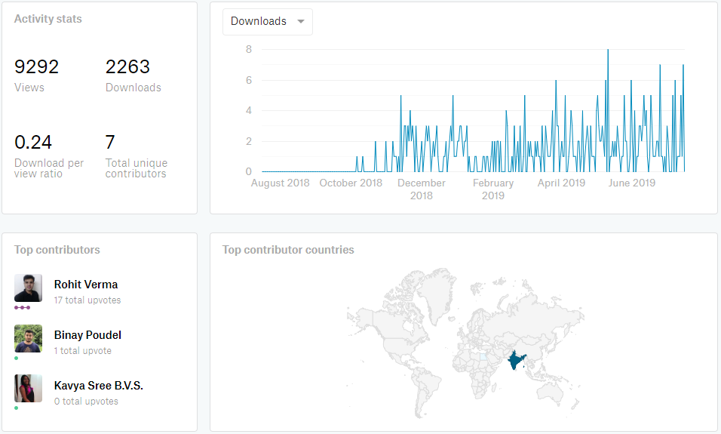
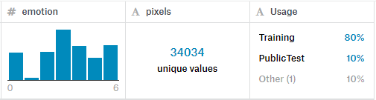
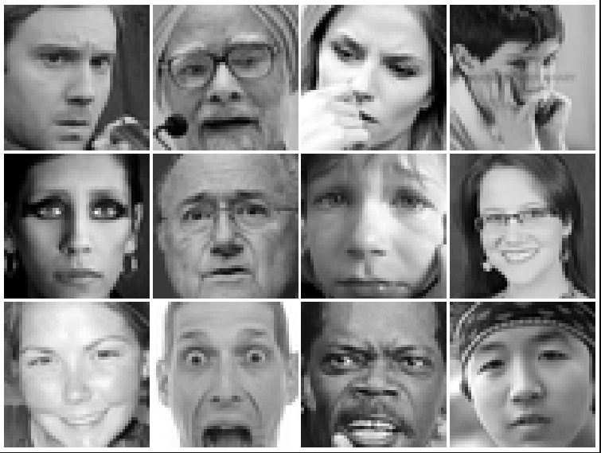
Fer2013 dataset
35,887 grayscale
48x48 sized face images with various emotions
7 emotions, all labeled
0: -4593 images- Angry 1: -547 images- Disgust 2: -5121 images- Fear 3: -8989 images- Happy 4: -6077 images- Sad 5: -4002 images- Surprise 6: -6198 images- Neutral
https://www.kaggle.com/deadskull7/fer2013

Slide 3

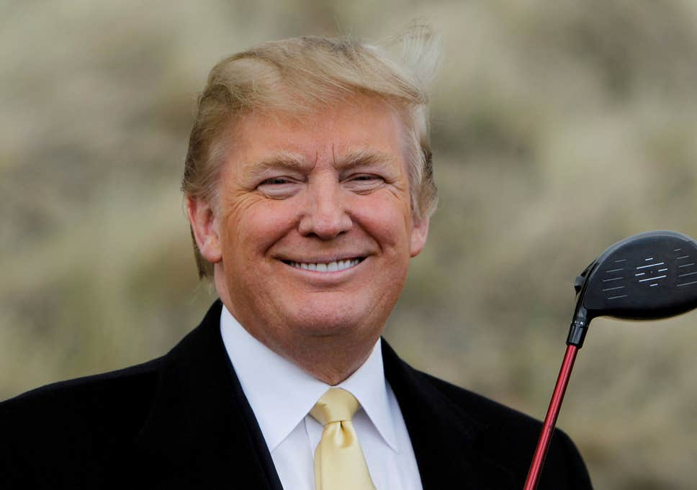

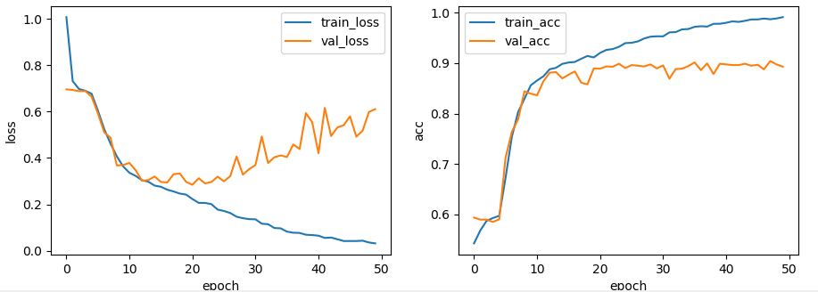
CNN structure, training
Input
CNN
Output
Neutral
Pool/2, Dropout 0.5
Pool/2, Dropout 0.5
Pool/2, Dropout 0.5
Pool/2, Dropout 0.5
3x3 conv, 128
3x3 conv, 256
3x3 conv, 512
3x3 conv, 64
3x3 conv, 128
3x3 conv, 256
3x3 conv, 512
Dense, 512
Dense, 128
3x3 conv, 64
Dense, 256
48x48
Happy
Train on 12301 images, validate on 1519 images (9-1)
Epochs = 50
Batch_size = 64
“ReLU” là activation function sử dụng cho tất cả layers
21

Slide 4

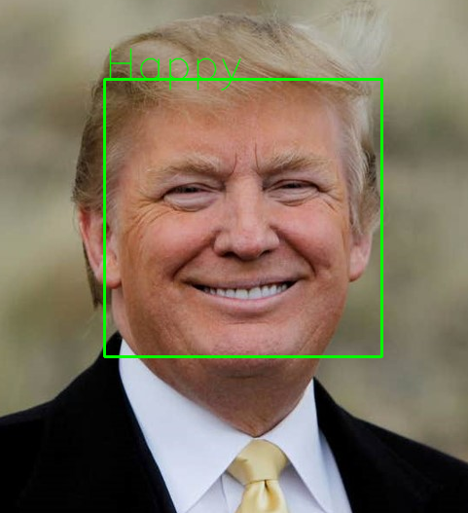
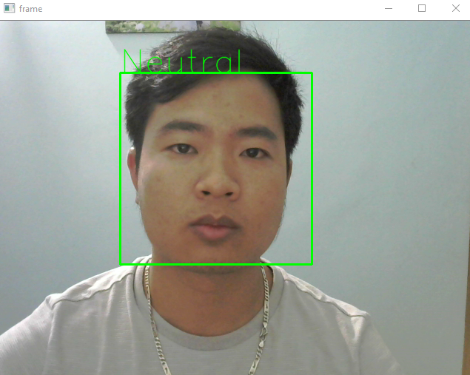

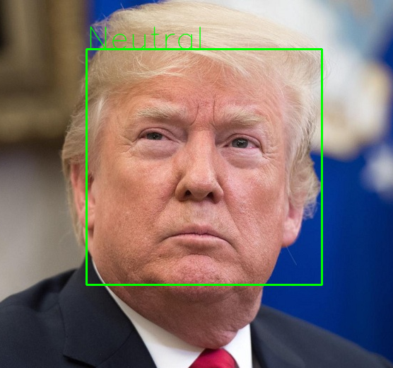
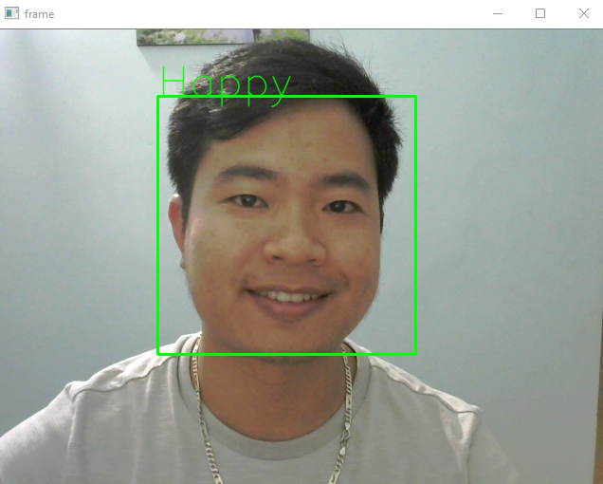
Testing
Acc: 90.65%
Test on 1367 images
● Test example Donald Trump
● Webcam realtime

